Slide 1
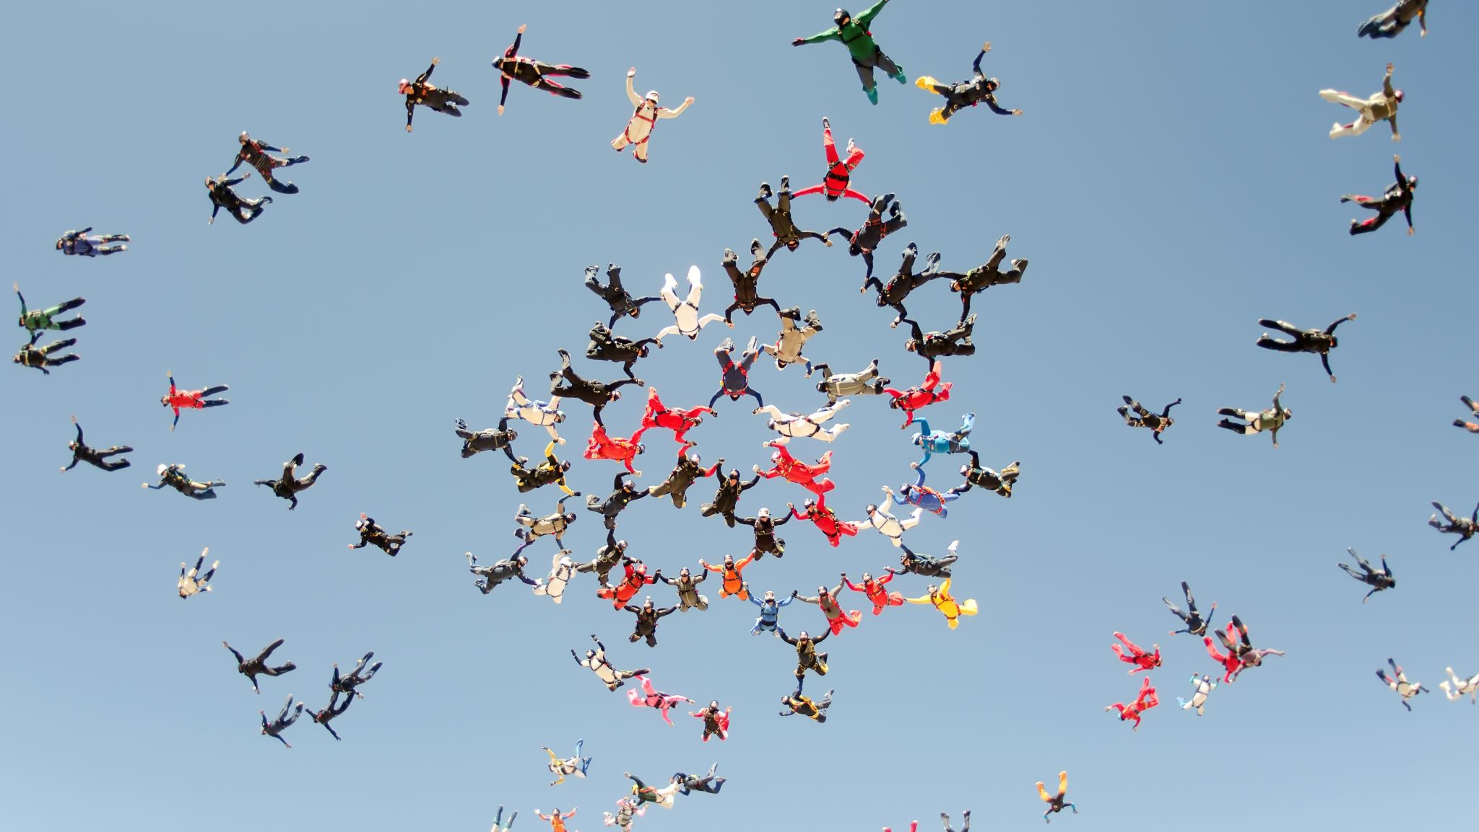
Alumni Association of Al Ihsan Academy (4As)
Organization and Guidelines

Slide 2
Vision
The ISNS Alumni Association aspires to be a primary linkage between the ISNS masjid and its family of alumni across United States, to commit them to the ISNS missions of life-long learning, community service, establishment of next generation Muslim leadership and engagement, and to attract them to the roots where they once started.

Slide 3
Mission & Purpose
The ISNS Alumni Association is an entity part of ISNS Board managed “Alumni Association Committee” whose purpose is to promote the welfare of the ISNS and Islamic youth by cultivating a mutually beneficial relationship between ISNS and its growing community of Muslims in the north west suburbs of Chicago.
This Alumni Association provides and supports alumni programs and services, facilitates communication with alumni, and seeks to strengthen alumni bonds of fellowship, professional association and ISNS affiliation.
The Alumni Association leverages the resources, talents, and initiatives of alumni and friends to advise, guide, advocate for and support the Association and the ISNS in achieving their respective missions and goals.
The Alumni Association provides an alumni network and encourages alumni engagement in the Muslim community of north west Chicago.
The Alumni Association coordinates activities for advancing the ISNS academic, administrative and outreach programs.
The Alumni Association encourages alumni to stay connected and serve as advocates for the Muslim community in the north west suburbs of Chicago, IL.

Slide 4
Principles & Values
The cornerstone of our core values is found in the ISNS mission and vision statement.
We affirm the value of diversity and the enrichment it brings to our lives and acknowledge our differences, rejecting all forms of prejudice and discrimination.
We value integrity, honesty, ethical behavior and strive to maintain a environment that is built on mutual respect, understanding and freedom of expression.
We share the ISNS commitment to life-long learning, community service, future Muslim leadership and engagement.
We value fellowship, personal growth, development and the concept of community on a suburban level
We value civility and good behavior in our support of all programs of the ISNS while demonstrating a high degree of respect for our fellow communities in the area.

Slide 5
Islamic Society of Northwest Suburbs
Al-Ihsan Academy Alumni Association
ISNS Board Ad-hoc committee & Alumni Association linkage
M
A
N
A
G
M
E
N
T
O
V
E
R
S
I
G
H
T
President
Chairman, Member1
President
ISNS BOARD
Al Ihsan Academy Alumni Association (AAAA)
Committee Members
Al Ihsan Academy Alumni Association (AAAA)
Association Officers
Member 3
Member 2
ALUMNI
Treasurer
Secretary
More etc.

Slide 6
ISNS Alumni Association Officers Structure
ISNS Board
President
4A’s Organization Structure
Vice President
Director
Communication
Director
Membership
Secretary
Treasurer
Director
Events Planning

Slide 7
Responsibilities
President: Oversees all aspects of association and serves as chairman of the board.
Vice President: Assists president and oversees three functional directors below. Can also be utilized as chair-elect.
Secretary/Treasurer: Manages finances and maintains association’s budget. Also publishes minutes from board meetings.
Director of Membership: Manages association’s database and membership recruitment activities.
Director of Communication: Oversees communications plan of association (newsletters, email, social media, website, Shield & Diamond).
Director of Events: Plans and executes association’s events.
Director of Fundraising : Coordinates all fundraising opportunities.

Slide 8
Guidelines
An Alumni Association may conduct the following activities:
Develop programs that support the goals and objectives of the ISNS, especially in campus fundraising as directed by the ISNS.
Provide activities, services, and programs to its alumni, including organizing on- and off-ISNS events such as reunions and homecoming activities, travel opportunities, networking, and printed and electronic communications.
Provide direct and in-kind support to the ISNS with the Alumni Association’s board of directors (Alumni Association Board).
In addition, the Alumni Association should maintain minutes of the meeting and records for its alumni affairs.
Any proposed exceptions to these guidelines must be approved in writing by the ISNS Board or designee. Any proposed amendments to these guidelines must be approved by the ISNS Board the recommendation of the Adhoc Committee.

